Slide 1

Highlighting the factors that can make Foundation writers’ English appear unacademic
Matthew Lemon, University of York
matthew.lemon@York.ac.uk

Slide 2
Outline
1 Features of IELTS writing
2 Genre analysis
3 SFL transitivity analysis
4 Lexical density
5 Recommendations

Slide 3

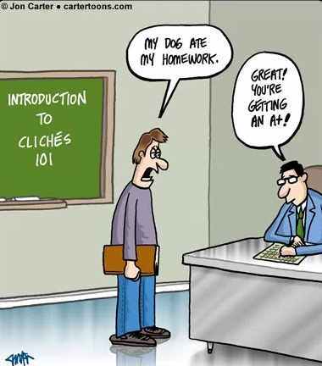
Writing chestnuts
Nowadays/in recent years/with today’s…
With the development of society…
Hot topic
A double-edged sword
In the modern world
As we all know
Source: crystalgraphics.com
Source: cartertoons.com

Slide 4
Features of IELTS writing tasks
writing as a spontaneous activity;
writing as opinion-giving;
evidence as anecdote, experience;
writing as hortation (Should X be done?);
real world phenomena as proper subject of writing;
writing as an activity separate from reading.
Source: Moore and Morton, p63, 2005

Slide 5
The native tongue should be banned from the TESOL classroom.
To what extent do you agree with this statement? Clearly state your stance, provide arguments to support this stance and explain why you disagree with the counter-arguments.

Slide 6
You should spend about 40 minutes on this task
Write about the following topic:
The native tongue should be banned from the TESOL classroom.
To what extent do you agree or disagree?
Give reasons for your answer and include any relevant examples from your own knowledge or experience.
Write at least 250 words.

Slide 7
The first reason why I hold this opinion is that TESOL class creates a perfect environment for us to speaking the same language. We should grasp the chance to practicing our speaking. Though it is hard to talk in the non-mother tongue at beginning, you have to hang on and struggle through tough times. If you always do what you can do, you will never be the one you can be.

Slide 8
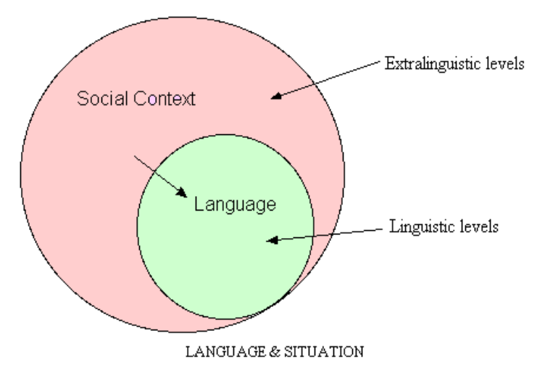

Slide 9
Features of academic writing
Complexity
Formality
Precision
Objectivity
Explicitness
Accuracy
Hedging
Responsibility
Organisation
Planning
Source: Uefap.org, n.d.

Slide 10
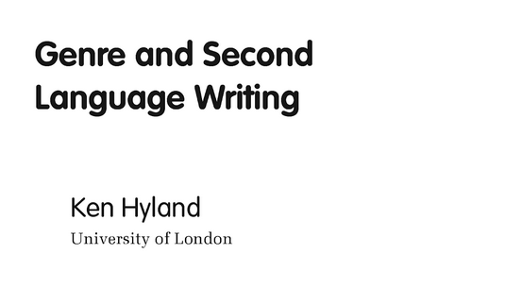

Slide 11
1 - Thesis
Introduces the proposition to be argued.
MOVE
(Gambit)
Attention Grabber — controversial statement or dramatic illustration.
(Information)
Presents background material for topic contextualization.
(Evaluation)
Positive gloss
(Marker)
Brief support of proposition.
Introduces and/or identifies a list.
Source: Hyland, p69, 1990

Slide 12
2. Argument
Discusses grounds for thesis. (Four move argument sequence can be repeated indefinitely)
Marker
Signals the introduction of a claim and relates it to the text.
(Restatement)
Rephrasing or repetition of proposition.
Claim
States reason for acceptance of the proposition. Typically based on:
a. Strength of perceived shared assumptions.
b. A generalization based on data or evidence.
c. Force of conviction
Support
States the grounds which underpin the claim. Typically:
a. Explicating assumptions used to make claim.
b. Providing data or citing references.
Source: Hyland, p69, 1990

Slide 13
3 Conclusion
Synthesizes discussion and affirms the validity of the thesis.
(Marker)
Signals conclusion boundary
Consolidation
Presents the significance of the argument stage to the proposition.
(Affirmation)
Restates proposition.
(Close)
Widens context or perspective of proposition
Source: Hyland, p69, 1990

Slide 14
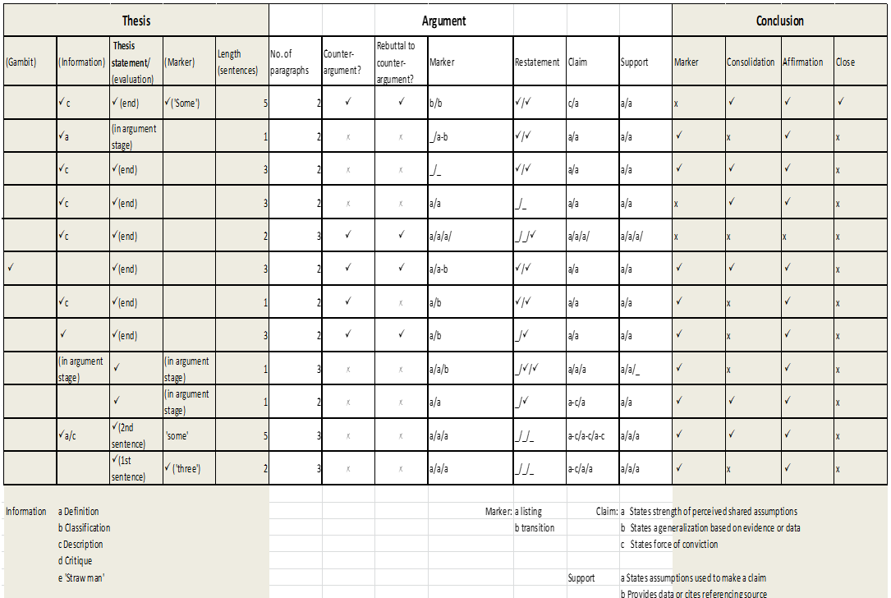

Slide 15
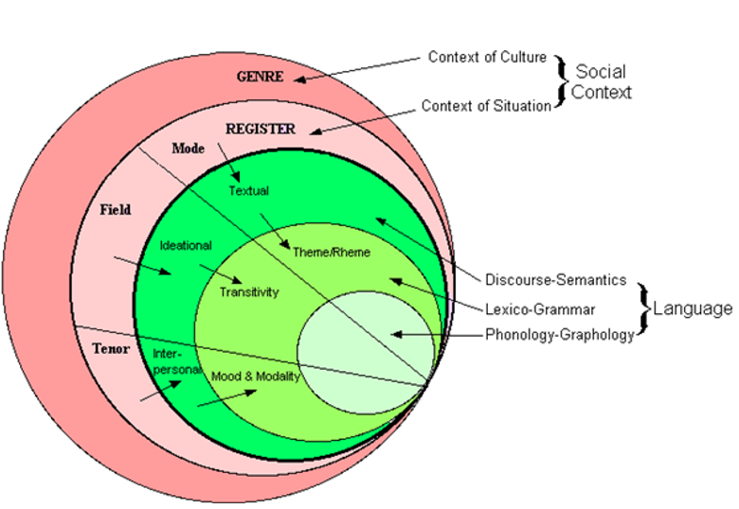
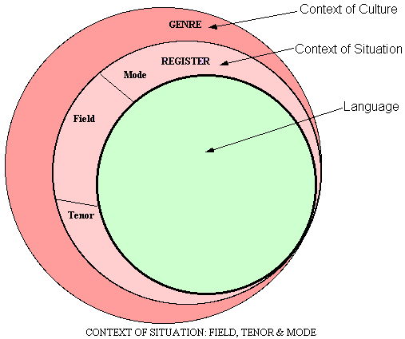
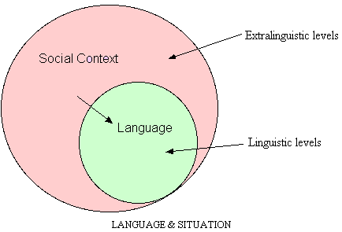
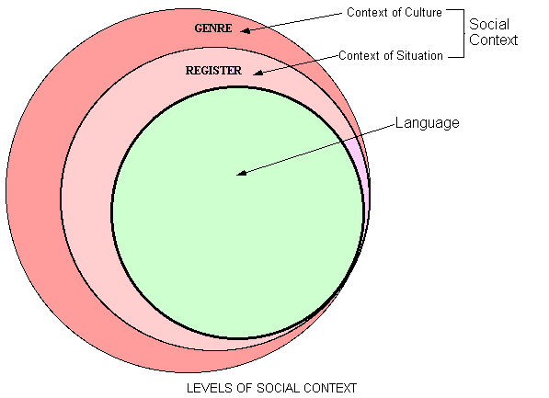
Source: Uefap (n.d.)

Slide 16
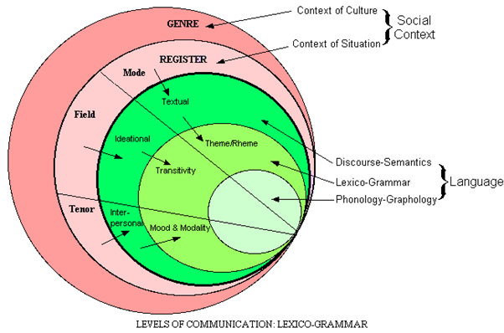
Application of SFL
Register
  Field: What is going on where
  Tenor: The way you relate to the other people
  Mode: The medium of communication
Discourse semantics
  Ideational: Ideas & relationship of ideas
  Inter-personal: Relationship of author/speaker to audience
  Textual: How language organises the text
Lexico-grammar
Transitivity: Types of processes
Mood: Declarative/interrogative, etc.
Modality: Judgment and attitude
Theme/Rheme: Ordering of information in clause
{
(Martin, 2010)
Source: Uefap, n.d.

Slide 17
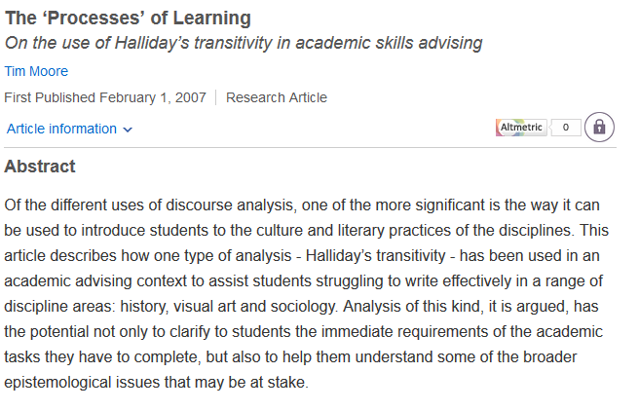

Slide 18
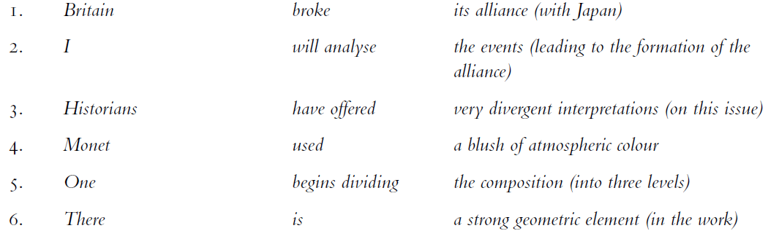
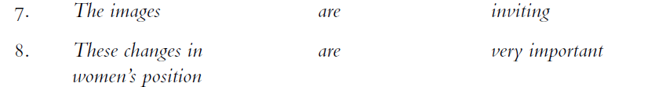
Traditional grammar analysis
Source: Moore, p54, 2009

Slide 19
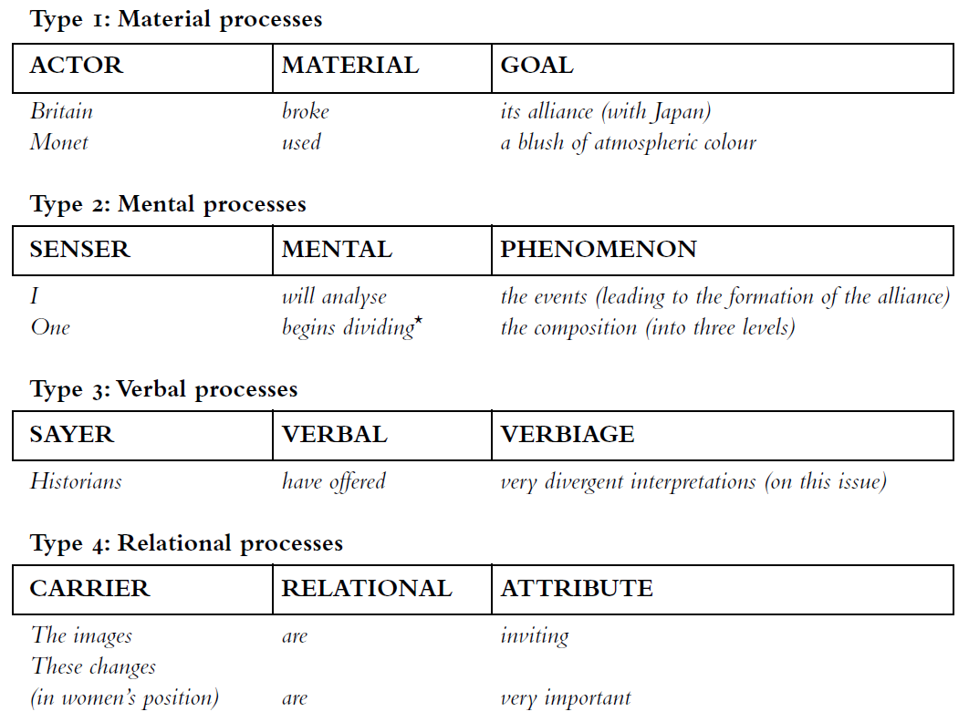

SFL Transitivity Analysis
Source: Moore, p55, 2009

Slide 20
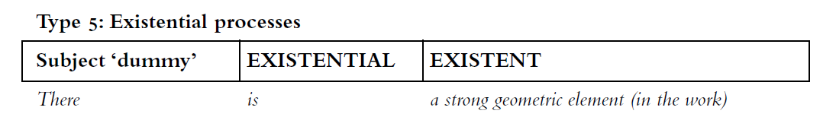
Source: Moore, p55, 2009

Slide 21
The first reason why I hold this opinion is that TESOL class creates a perfect environment for us to speaking the same language. We should grasp the chance to practicing our speaking. Though it is hard to talk in the non-mother tongue at beginning, you have to hang on and struggle through tough times. If you always do what you can do, you will never be the one you can be.

Slide 22
SFL Transitivity analysis
We should grasp the chance to practicing our speaking.
Participant/Process/Participant
Material process
We=actor
Grasp=material process
The chance…=Goal

Slide 23
 | Participant use of I/my | Participant use of you/your | Participant use of we/our | Participant use of they/ their
 | 6 | 8 | 1 | 2
 | 2 | 0 | 0 | 4
 | 1 | 0 | 0 | 1
 | 4 | 9 | 6 | 0
 | 3 | 0 | 0 | 4
 | 2 | 0 | 9 | 5
 | 1 | 0 | 7 | 0
 | 1 | 0 | 1 | 4
 | 3 | 0 | 0 | 3
 | 4 | 0 | 5 | 2
 | 1 | 0 | 6 | 0
 | 3 | 4 | 0 | 2
Total | 31 | 21 | 35 | 27

Slide 24
Lexical density
The first reason why I hold this opinion is that TESOL class create a perfect environment for us to speaking the same language. We should grasp the chance to practicing our speaking. Though it is hard to talk in the non-mother tongue at the beginning, you have to hang on and struggle through the tough times. If you always do what you can do, you will never be the one you can be.
The first reason why I hold this opinion is that//TESOL class create a perfect environment for us to speaking the same language. //We should grasp the chance to practicing our speaking. //Though it is hard to talk in the non-mother tongue at the beginning, //you have to hang (on) and struggle through the tough times. //If you always do what you can do, //you will never be the one you can be.

Slide 25
Lexical density
The first reason why I hold this opinion is that//TESOL class create a perfect environment for us to speaking the same language. //We should grasp the chance to practicing our speaking. //Though it is hard to talk in the non-mother tongue at the beginning, //you have to hang (on) and struggle through the tough times. //If you always do what you can do, //you will never be the one you can be.
(Lexical items) 23 / (Clauses) 7
Lexical density=3.29

Slide 26
Crime was increasing rapidly and the police were becoming concerned.
The rapid increase in crime was causing concern among the police.

Slide 27
Informal | Formal
Crime was increasing rapidly and the police were becoming concerned | The rapid increase in crime was causing concern among the police.
Germany invaded Poland in 1939. This immediately caused World War Two to break out. | Germany’s invasion of Poland in 1939 was the immediate cause of the outbreak of World War Two
We engaged staff in the initiative by encouraging them to attend lunchtime meetings | The engagement of staff in the initiative was encouraged by attendance at lunchtime meetings
Source: https://theplenary.wordpress.com/tag/formality/

Slide 28
The first reason why I hold this opinion is that//TESOL class create a perfect environment for us to speaking the same language. //We should grasp the chance to practicing our speaking. //Though it is hard to talk in the non-mother tongue at the beginning, //you have to hang (on) and struggle through the tough times. //If you always do what you can do, //you will never be the one you can be.
(Lexical items) 23 / (Clauses) 7
Lexical density=3.29
The first reason for this is that//TESOL classes create the perfect environment for speaking the same language. //It is important to practise speaking for a number of reasons. //Beginning to learn a language requires hard work and patience. //Doing only what has been done before limits potential.
(Lexical items) 25 / (Clauses) 5
Lexical density=5

Slide 29
Paragraph 2
To begin with, it is impolite if Chinese always speak Chinese in the TESOL classroom. //We would ignore other people’s feelings, //since we have two classmates and our tutors who cannot speak Chinese //and can’t understand what we are saying. //Also, if the native tongue is banned in the classroom, //we can create an English environment to help us practise English well, especially English listening and speaking, //as it is not easy for us to find an English environment in our country. //What’s more, if everybody speaks English in the classroom, //we can make more friends who are not Chinese.
(Lexical items) 40 / (Clauses) 9
Lexical density=4.45

Slide 30
Collaborative rewrite 1
To begin with, for the reason that there are classmates and tutors who can not speak Chinese, it //is impolite that Chinese always speak Chinese in the TESOL classroom. //As a result, it would ignore other people’s feelings. //Meanwhile, banning the native tongue in the classroom is an essential requirement to create an English environment. //What’s more, if everybody speaks English in the classroom, //making friends who are foreigners become easier.
(Lexical items) 32 / (clauses) 6
Lexical density=5.33

Slide 31
Collaborative rewrite 2
To begin with, it is impolite for Chinese to speak mother tongue in TESOL classroom. //This ignorance of tutors and classmates’ feelings could lead to the misunderstanding of the speaking content. //Also, creating an English environment is helpful to practise English listening and speaking skills //*because the lack of English learning environment in China. //What’s more, speaking English could help students to make foreign friends.
*(I have considered this to be a clause despite the fact that it lacks a verb)
(Lexical items) 36 / (Clauses) 5
Lexical density=7.2

Slide 32
Collaborative rewrite 3
To begin with, keeping speaking Chinese in the TESOL classroom will be impolite. // Being in multinational classroom and remaining speaking the native tongue will lead to ignoring other people’s feelings. // Creating an effective English learning environment requires the first language being banned. // Making more foreign friends will be successful if everybody maintains this rule.
(Lexical items) 30 / (Clauses) 4
Lexical density=7.5

Slide 33
Recommendations
Bear in mind how big a leap it is for students going from IELTS to academic writing
Make students explicitly aware of the features of the genre
Show students the gap by allowing them to compare their writing to model answers
Use revised versions of students’ own work to highlight the gap
Extracting information from reading texts and putting it in to their own words is extremely challenging - so:
  Explicitly teach vocabulary and how to change word forms
  Explicitly teach note-taking methods

Slide 34
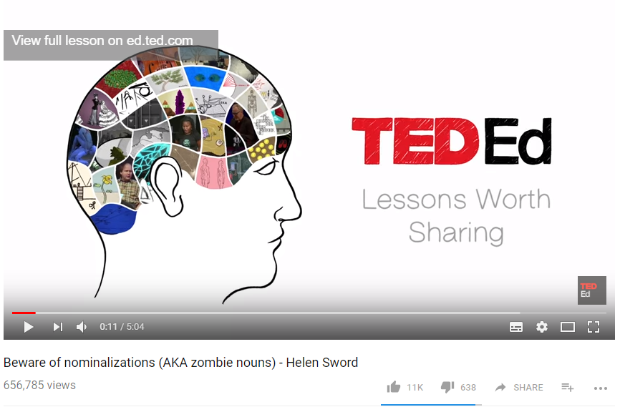
A warning about the dangers of over-nominalisation

Slide 35
References
Coffin, C. (2010) Introduction in Coffin, C., Lillis, T. & O’Halloran, K. (eds.) Applied linguistics methods: a reader. Oxon: Routledge
Halliday, M.A.K. rev. Matthieson, C.M.I.M. (2014) Halliday’s introduction to functional grammar. Oxon: Routledge
Hyland, K., (1990). A genre description of the argumentative essay. RELC journal, 21(1), pp.66-78.
Martin, J. (2010) Language, register and genre in Christie, F. (ed.) Children writing: a reader. Geelong: Deakin University Press
Milton, J., (2010). The development of vocabulary breadth across the CEFR levels. Communicative proficiency and linguistic development: Intersections between SLA and language testing research, pp.211-232.
Moore, T. (2011). The ‘processes’ of learning: On the use of Halliday’s transitivity in academic skills advising in Coffin, C., Lillis, T. & O’Halloran, K. (eds.) Applied linguistics methods: A Reader. Oxon: Routledge
Moore, T. and Morton, J. (2005). Dimensions of difference: a comparison of university writing and IELTS writing. Journal of English for Academic Purposes 4, 43–66
Swales, J. (1990). Genre analysis: English in academic and research settings. Cambridge: Cambridge University Press.
Uefap (n.d.). Levels of communication lexicogrammar. [online] available at http://www.uefap.com/grammar/intro/sfl-intro.htm [accessed 9 March 2017]
Uefap (n.d.). Features of academic writing. [online] available at http://www.uefap.com/grammar/intro/sfl-intro.htm [accessed 9 March 2017]

